Slide 1


Introduction to
Robotic Process Automation
SHOPPING ROBOT BOT
Your Register No. 220701248
Name : Sanjay S
Guide Name : Dr. N. Durai Murgan
Designation and Department : Associate Professor / CSE

Slide 2
Abstract
The Shopping Robot project, developed using UiPath Studio, automates the process of online product search, data collection, and analysis. The user inputs a product name through a message box, prompting the robot to search for the product on Amazon. Key product details such as name, price, and ratings are extracted through data scraping and stored in an Excel sheet for structured analysis. The robot identifies the top five products based on user-defined criteria, generates a Word document highlighting these products, and includes insights on the maximum and minimum priced items with their respective names. Additionally, the robot offers the functionality to add selected items to the shopping cart, enhancing convenience and interactivity. This project demonstrates the application of robotic process automation (RPA) in simplifying online shopping tasks, providing users with an efficient and error-free experience.

Slide 3
Need for the Proposed System
The need for the proposed Shopping Robot system arises from the increasing demand for automated solutions that streamline and enhance the online shopping experience. In today's fast-paced digital world, users often face the challenge of manually comparing products across various platforms, which is time-consuming and prone to errors. The Shopping Robot addresses this need by automating the entire process—searching for products, extracting key data such as price, name, and ratings, and organizing it for easy comparison. By storing the data in an Excel sheet and generating a Word document with the top 5 products, along with their price analysis, the system provides users with valuable insights to make informed decisions quickly. Additionally, the robot’s ability to add items to the shopping cart makes the shopping process seamless and efficient. Thus, the proposed system significantly reduces manual effort, enhances accuracy, and improves user productivity in online shopping.

Slide 4
Advantages of the Proposed System
Time Efficiency: The Shopping Robot automates the entire product search and data extraction process, saving users time by quickly retrieving relevant product information from Amazon without the need for manual browsing and comparison.
Error-Free Data Collection: By using automation to scrape product details such as name, price, and ratings, the system ensures consistent and accurate data collection, eliminating human errors typically associated with manual data entry.
Data Organization and Analysis: The system stores the scraped data in an organized Excel sheet, making it easier for users to compare products. It also analyzes the top 5 products and presents the highest and lowest priced items, helping users make well-informed purchasing decisions.
User-Friendly Interface: The simple message box input allows users to enter product names easily, providing a smooth and accessible experience, even for non-technical users, making online shopping more efficient.
Seamless Shopping Experience: In addition to gathering product information and generating reports, the system’s ability to add items to the shopping cart streamlines the shopping experience, making it a comprehensive solution for users who want to efficiently search, compare, and purchase products online.

Slide 5
Main Objective
The main objective of the Shopping Robot project is to automate the online shopping process by enabling users to search for products on Amazon, scrape essential details such as product name, price, and ratings, and present this information in a structured format. The robot stores the collected data in an Excel sheet for easy comparison, identifies the top 5 products based on user-defined criteria, and generates a Word document with the relevant product details, including maximum and minimum price insights. Additionally, it provides a seamless shopping experience by allowing users to add selected items directly to their cart. This project aims to improve the efficiency, accuracy, and convenience of online shopping through robotic process automation (RPA) in UiPath Studio.

Slide 6
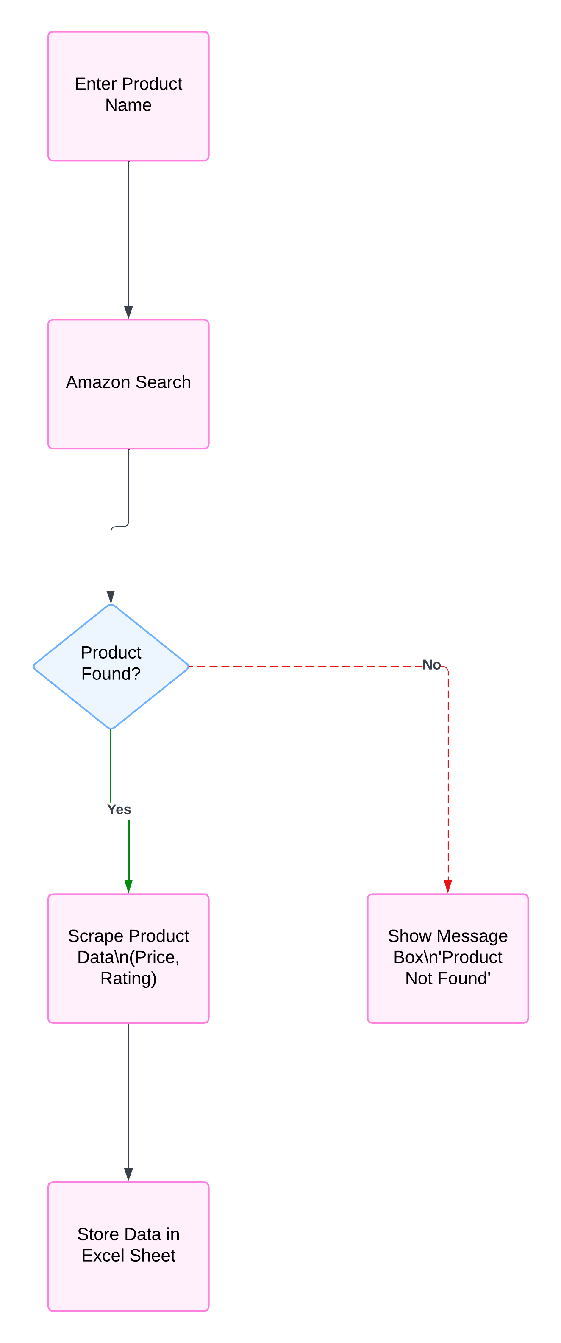
Architecture

Slide 7
System Requirements
Hardware Requirements:
Processor (CPU):
  Minimum: Intel Core i3 or equivalent
  Recommended: Intel Core i5 or higher
RAM:
  Minimum: 4 GB
  Recommended: 8 GB or more for better performance
Hard Drive:
  Minimum: 2 GB of free disk space
  Recommended: 5 GB or more (to store temporary files, project files, and data such as Excel sheets and Word documents)
Display:
  Minimum: 1366 x 768 resolution
  Recommended: Full HD (1920 x 1080) for improved usability and ease of working with UiPath Studio
Internet Connection:
  Required for product searches, data scraping, and accessing Amazon. A stable broadband connection is recommended.

Slide 8
System Requirements
Software Requirements:
Operating System: Windows 7 (64-bit) or higher
Windows 10 or later is recommended for better compatibility and performance.
UiPath Studio: UiPath Studio (Community or Enterprise Edition) for developing the RPA solution
Compatible with the latest version of UiPath Studio
.NET Framework 4.7.2 or higher
Microsoft Excel: Excel 2013 or later for storing and manipulating the scraped product data in spreadsheets.
Microsoft Word: Word 2013 or later for generating the document with top 5 product details.
Browser: Google Chrome, Mozilla Firefox, or Microsoft Edge (for web scraping via UiPath)
UiPath extensions for the browser need to be installed to enable automation on the Amazon website.
Additional Libraries: UiPath.Excel.Activities for working with Excel files.
UiPath.Word.Activities for working with Word documents.
UiPath.WebAPI.Activities (optional, for API-based automation or advanced web scraping)

Slide 9
Functional Description
Module 1: Product Search and Data Scraping
Short Description:
Module 1 focuses on automating the product search process on Amazon. The user enters a product name into a message box, and the robot uses web scraping techniques to search for the product on Amazon. It extracts essential product information, including the product name, price, and rating, and stores this data in an organized Excel sheet for easy analysis. This module lays the foundation for collecting product data and provides a structured approach to manage and process the scraped information.

Slide 10
Functional Description
Module 2: Data Analysis and Report Generation
Short Description:
Module 2 focuses on processing and analyzing the data collected in Module 1. It identifies the top 5 products based on the extracted details such as price and ratings. The robot then generates a Word document containing the names, prices, and ratings of these top 5 products. Additionally, it identifies and highlights the maximum and minimum priced products, providing insights into the price range of the products. This module ensures that users receive a clear, well-organized report to aid in decision-making.

Slide 11
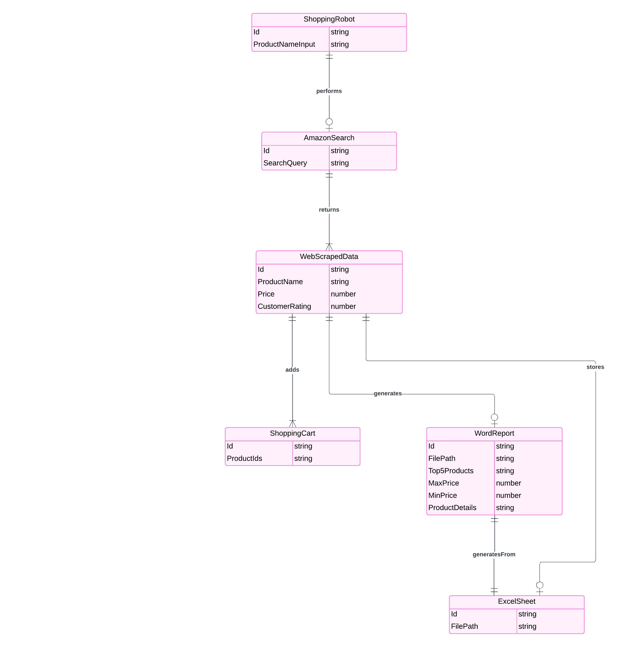
Table Design

Slide 12
Process Design
Main Process: Online Shopping Automation
The main process focuses on creating an end-to-end automated workflow that simplifies and streamlines the online shopping experience. This process leverages UiPath Studio's powerful automation tools to achieve efficiency, accuracy, and user satisfaction.
Key Objectives of the Main Process:
Automating Search and Data Collection: Eliminating manual effort by automatically searching for products and extracting relevant details.
Organizing and Analyzing Data: Storing data systematically and providing actionable insights through analysis and reports.
Enhancing Decision-Making: Assisting users in choosing the best products based on price and ratings.
Simplifying Purchases: Automating the addition of desired products to the shopping cart.

Slide 13
Process Design
Key Activities in the Main Process:
User Interaction:
  Providing an easy-to-use interface (message box) for entering the product name.
  Ensuring a smooth interaction between the user and the automated system.
Web Automation:
  Searching for the product on Amazon.
  Navigating the website to locate search results and extract data.
Data Scraping:
  Collecting detailed product information, including name, price, and rating, for all relevant results.
  Handling large data sets efficiently.

Slide 14
Process Design
Sub-Processes:
User Input Handling:
Purpose: To collect the product name from the user.
Steps:
  Display a message box prompting the user to enter the product name.
  Validate the input to ensure it is not empty or invalid.
Output: Validated product name.
Product Search:
Purpose: To search for the product on Amazon's website.
Steps:
  Open the Amazon website using a browser automation activity.
  Enter the product name in the search bar.
  Initiate the search by simulating a click on the search button.
Output: Amazon search results page.

Slide 15
Process Design
Data Storage:
Purpose: To save the scraped data for further analysis.
Steps:
  Open or create an Excel sheet.
  Write the scraped data into the appropriate columns (Product Name, Price, Rating).
  Save and close the Excel file.
Output: Excel file with product data.
Data Analysis and Report Generation
Purpose: To analyze the scraped data and generate a report.
Steps:
  Identify the top 5 products based on ratings and prices.
  Extract the products with the highest and lowest prices.
  Generate a Word document summarizing the findings.
    Include the top 5 products with their details.
    Highlight the maximum and minimum priced products.
  Save the Word document.
Output: Word document with a detailed report.

Slide 16
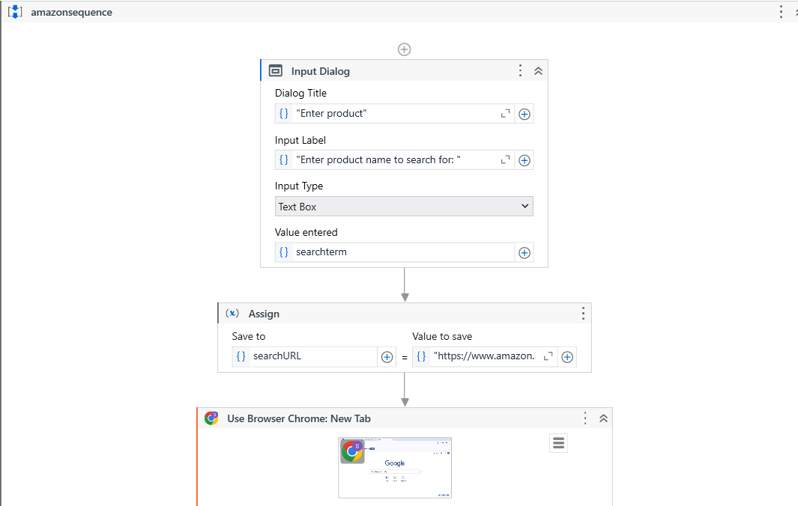
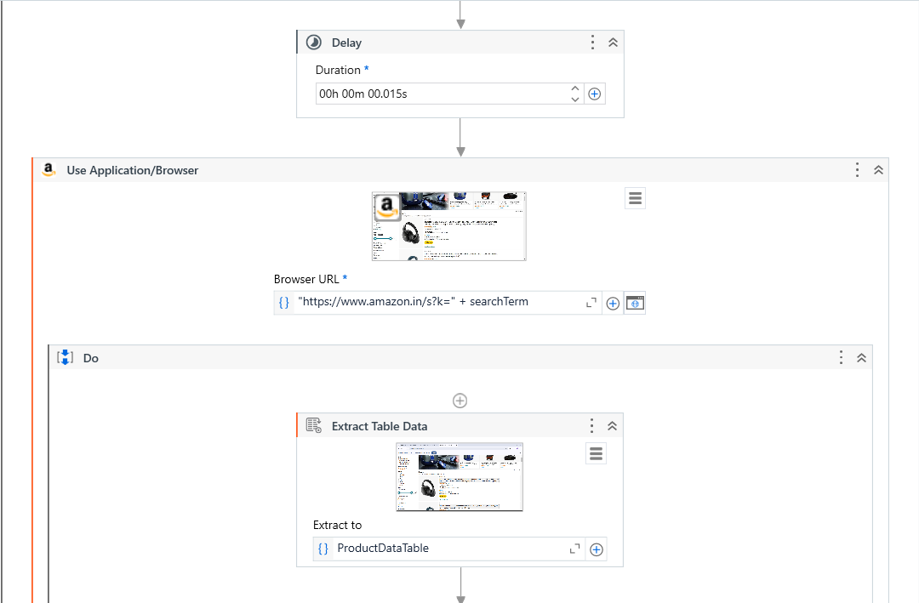
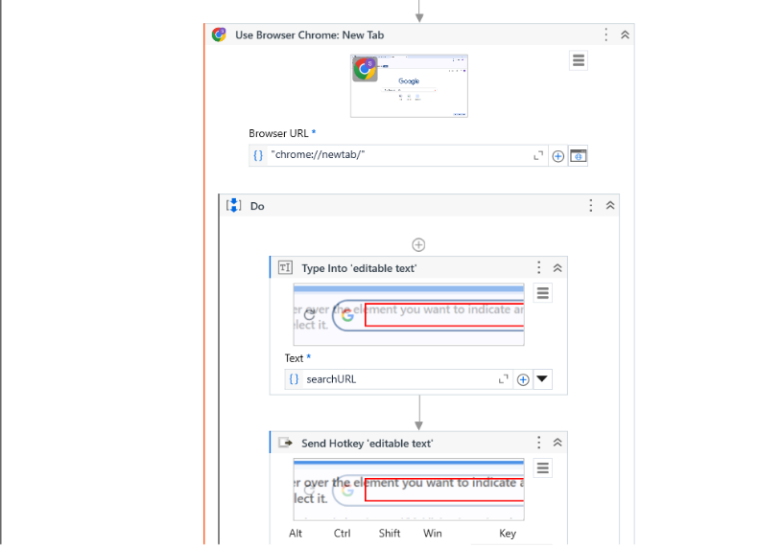
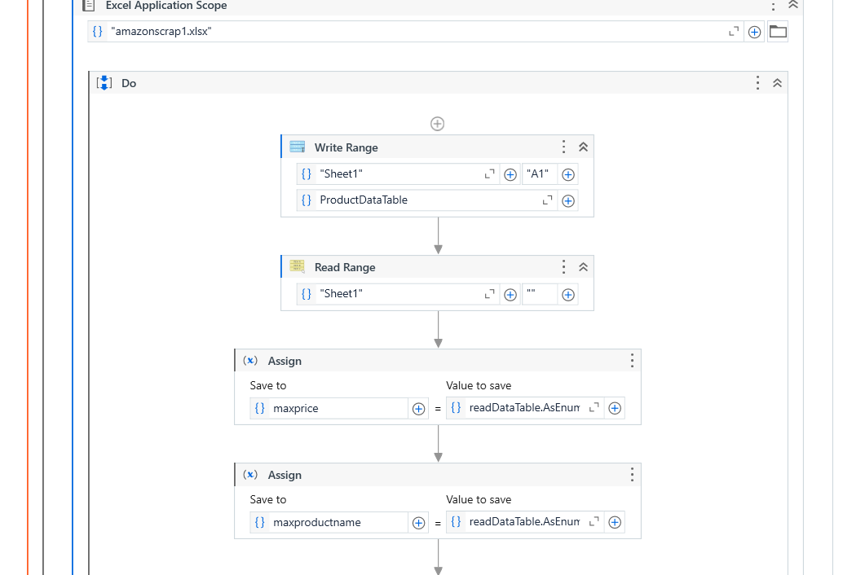
Workflow

Slide 17
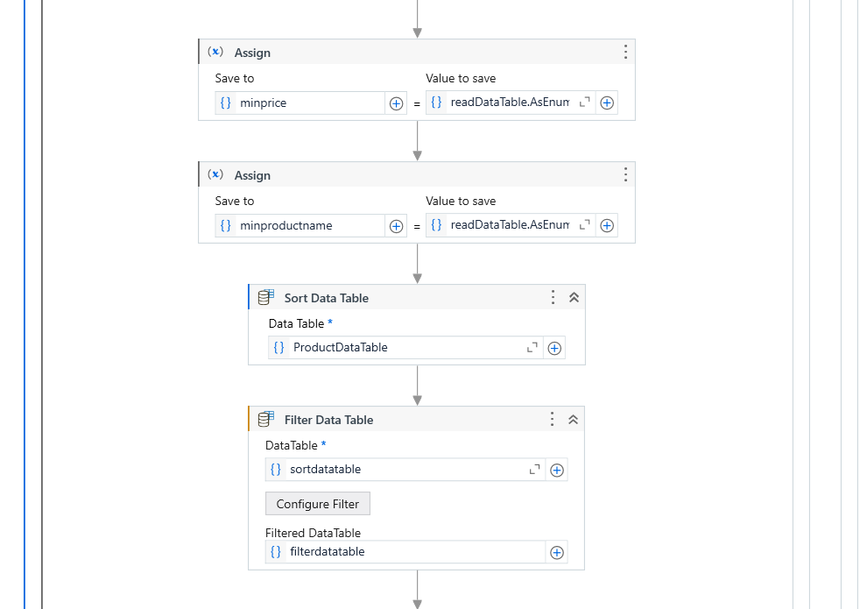
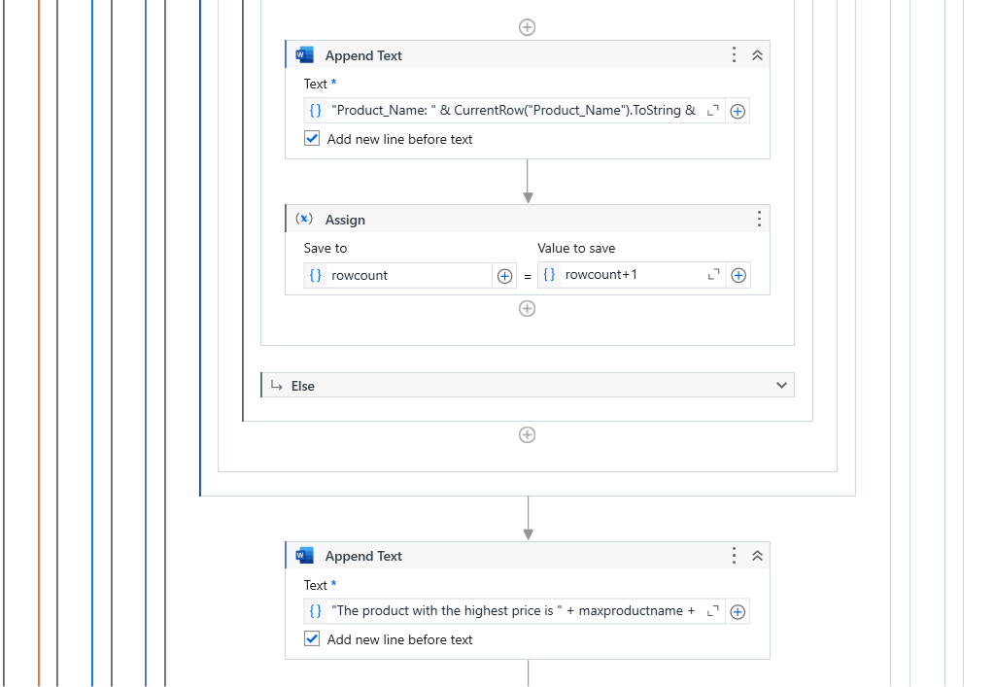
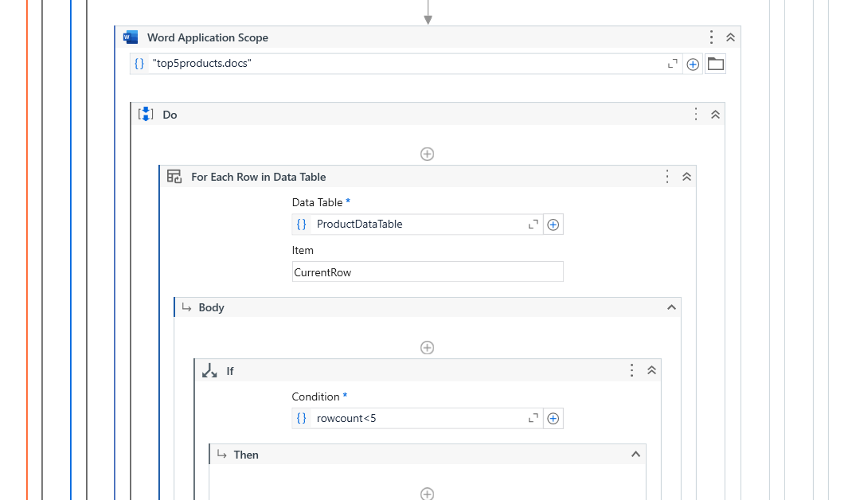
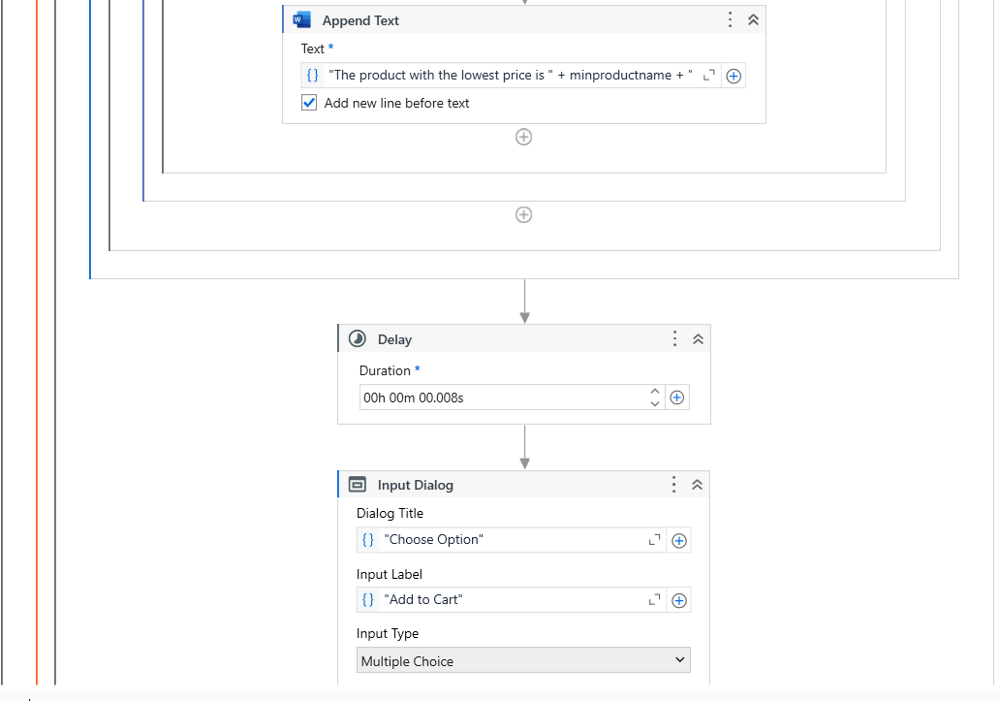
Workflow

Slide 18
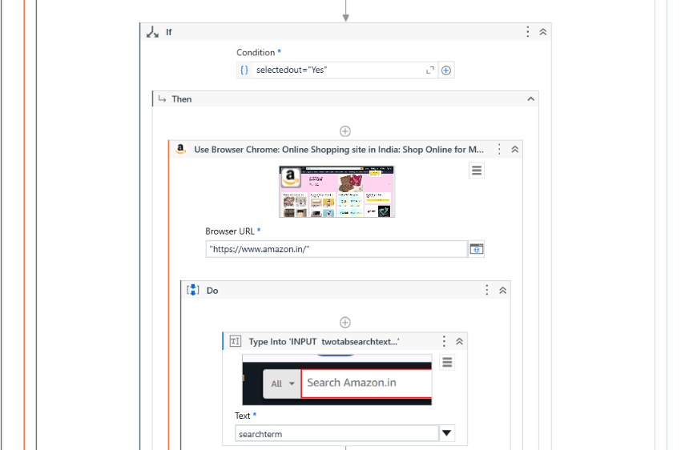
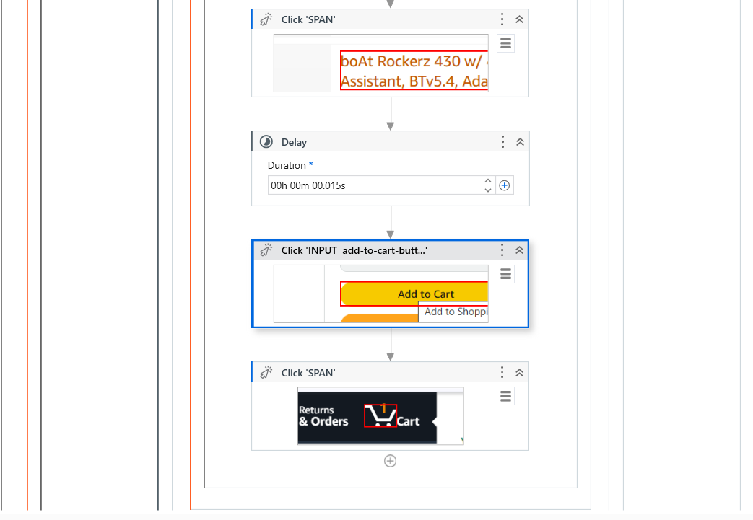
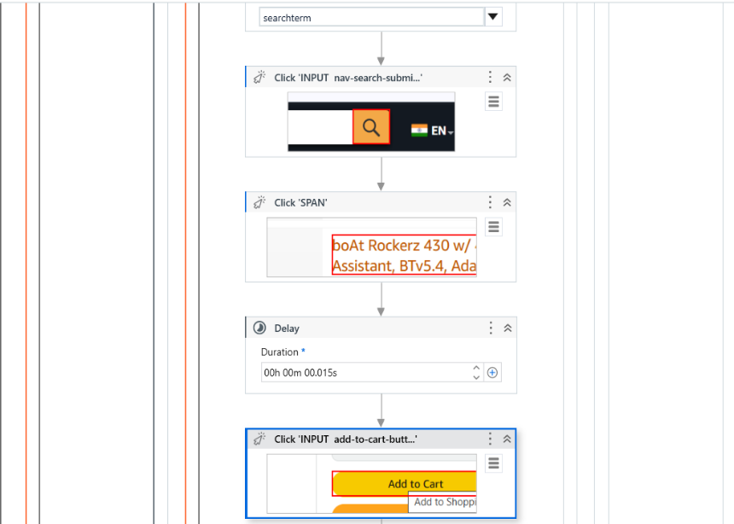
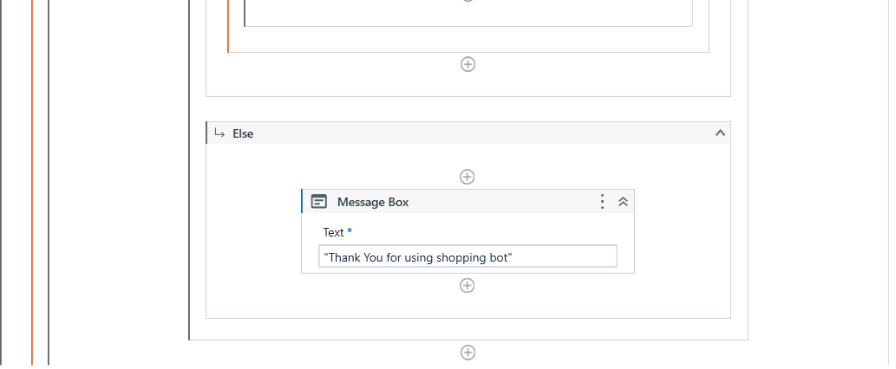
Workflow

Slide 19
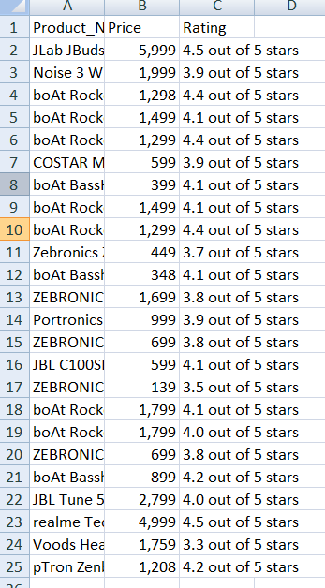
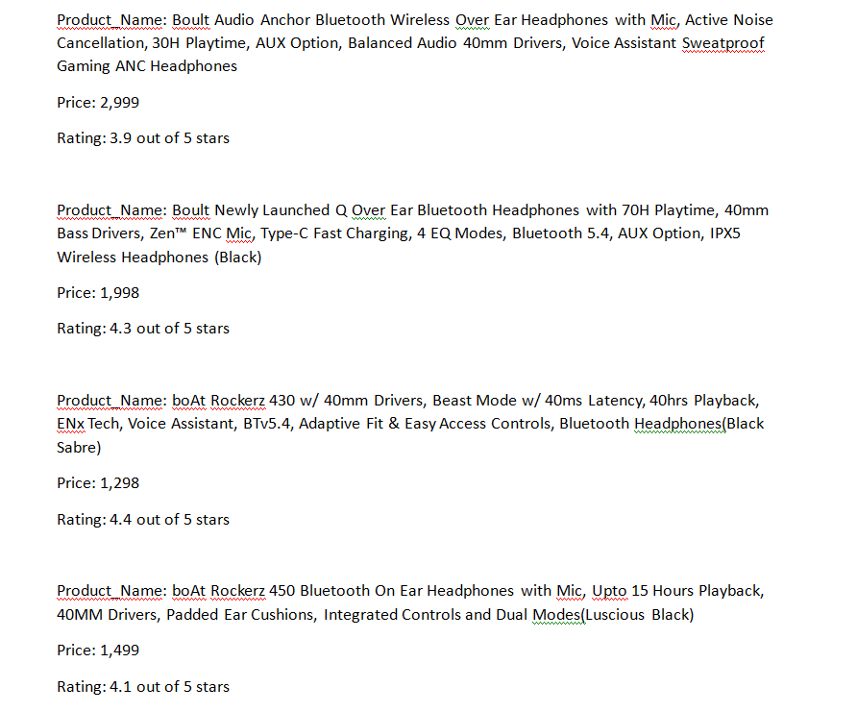
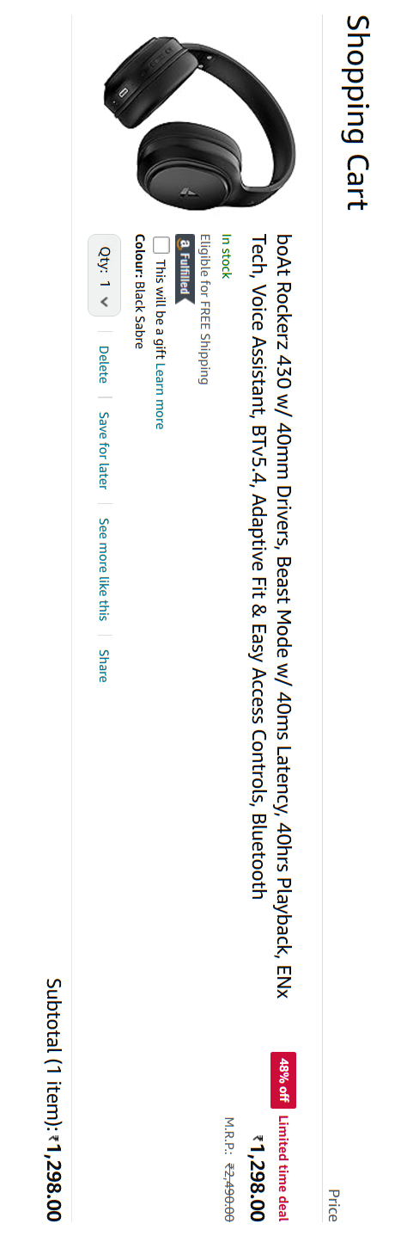
Testing

Slide 20
Conclusions
The Shopping Robot project demonstrates the significant potential of Robotic Process Automation (RPA) in enhancing the online shopping experience by automating repetitive and time-consuming tasks. By leveraging UiPath Studio, the project successfully enables users to search for products on Amazon, extract key details such as product name, price, and ratings, and store this data in an organized Excel sheet. The robot then identifies the top 5 products, providing valuable insights like maximum and minimum pricing, and generates a professional Word document to present these findings. Additionally, the system streamlines the shopping process by allowing users to add selected items to the cart with ease.
This project not only showcases the power of automation in simplifying online shopping but also emphasizes the ability to make informed purchasing decisions based on real-time, structured data. By eliminating manual effort and enhancing accuracy, the Shopping Robot offers a user-friendly and efficient solution that can be extended to other e-commerce platforms, integrated with personalized recommendations, and even expanded to mobile and voice-based interfaces in the future.
In conclusion, the Shopping Robot represents a significant advancement in the application of RPA, providing users with a seamless, accurate, and time-saving online shopping experience while offering opportunities for future enhancements to further optimize its functionality.

Slide 21
Future Enhancement
Integration with Multiple E-commerce Platforms
Price Comparison and Alerts
Advanced Product Filters
User Authentication and Personalized Experience
Integration with Payment Systems
Advanced Data Analytics and Visualization
AI-powered Product Recommendations
Multi-Language and Multi-Currency Support
Voice Command Integration
Mobile Application Version

Slide 22
References
1. Books:
RPA: Robotic Process Automation by Alok Mani Tripathi – A comprehensive guide on how to implement RPA solutions using tools like UiPath.
Learning Robotic Process Automation by Alok Mani Tripathi – A beginner-friendly book for understanding RPA concepts and UiPath.
2. Research Papers and Articles:
Robotic Process Automation (RPA) in E-Commerce – Research articles discussing the role of RPA in automating online shopping processes.
Batra, R., & Gupta, P. (2020). Exploring the Impact of Robotic Process Automation in E-Commerce - Journal of Automation and AI.
3. UiPath Official Documentation and Tutorials:
UiPath Documentation: https://docs.uipath.com/ – The official documentation provides detailed guides, activities, and workflows on how to use UiPath Studio.
UiPath Academy: https://academy.uipath.com/ – A collection of free training courses and tutorials on UiPath, useful for learning how to build automation solutions.

Slide 23
Thank You

